Slide 1
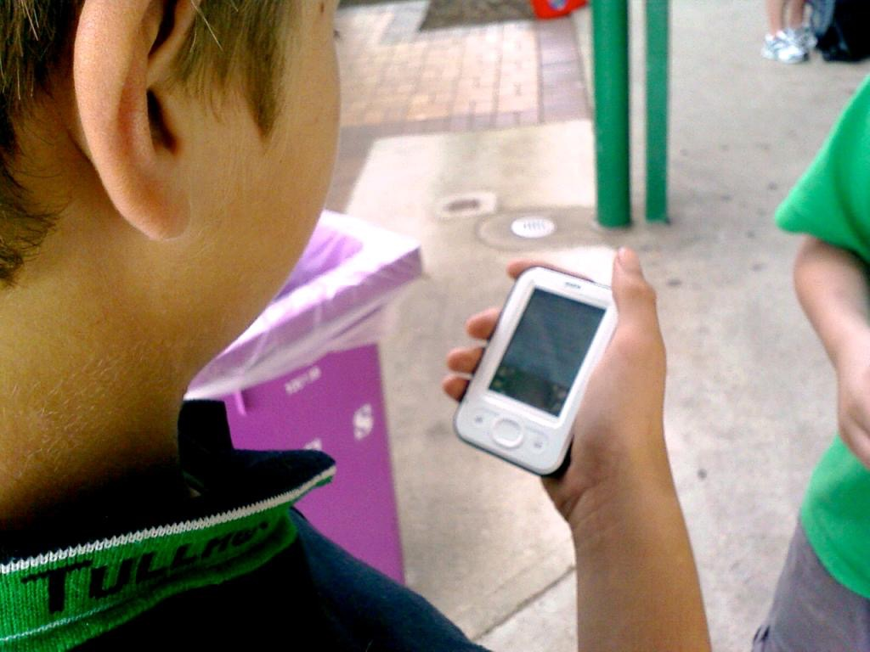
My Online Community
NLMUSD Digital Citizenship Grades 2-3
cc: jnxyz - https://www.flickr.com/photos/94338545@N00

Slide 2
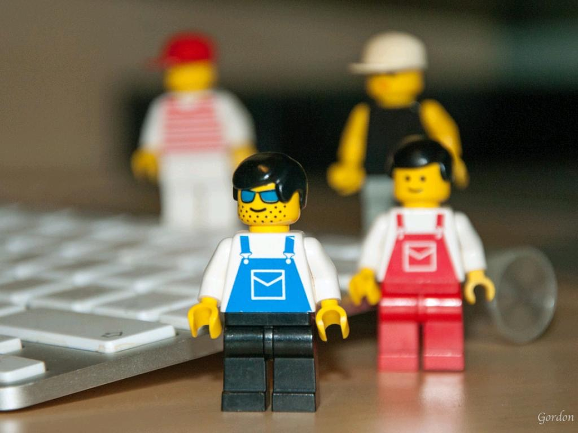
My Online Community
How does the Internet connect you to others?
cc: Gordon McKinlay - https://www.flickr.com/photos/78251058@N00
Notes:
Students explore the concept that people can connect
with one another through the Internet. They understand how the ability for people to communicate online can unite a community.
Students discuss the nature of the Internet, and understand that while it is not a “real” physical place, it is made up of real people. They use a
graphic representation to explain the different in-person connections they have with their family, friends, and community. Students then use
the same graphic model to represent how they could connect to others on the Internet by creating maps of their potential online community.

Slide 3
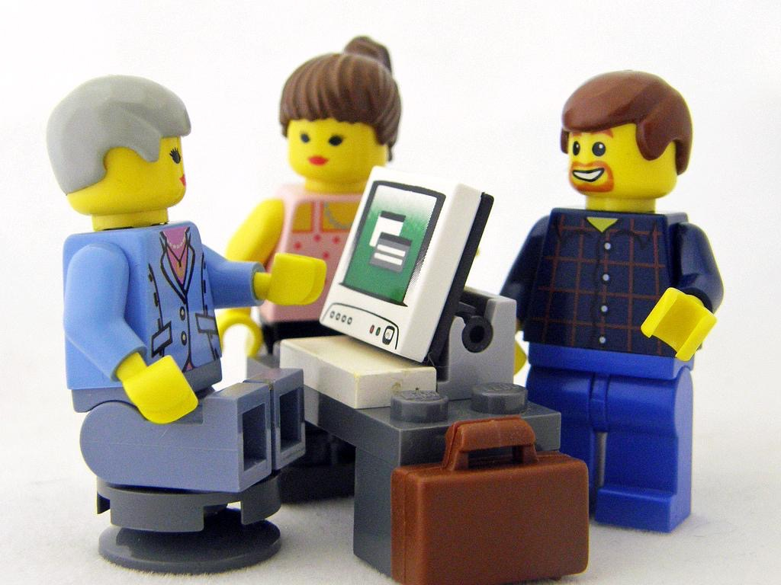
After this lesson, you will learn to
Consider what it means to go online and use the Internet.
Compare and contrast how they are connected to different people and places, in person and on the Internet.
Demonstrate an understanding of how people can connect on the Internet by drawing a map of your online community.
cc: Kaptain Kobold - https://www.flickr.com/photos/95492938@N00

Slide 4
video
What is the Internet?
Notes:
Introduction
Warm-up
SHOW
students the “What Is the Internet?” video.
INVITE
students to share their reactions to the video.
What did they agree with?
How would they describe the
Internet to a younger sibling, cousin, or friend?

Slide 5
Key Vocabulary
Online: connected to the Internet
Internet: a worldwide network that connects people using computers, phones, or other devices
cc: jjackowski - https://www.flickr.com/photos/74762807@N00

Slide 6
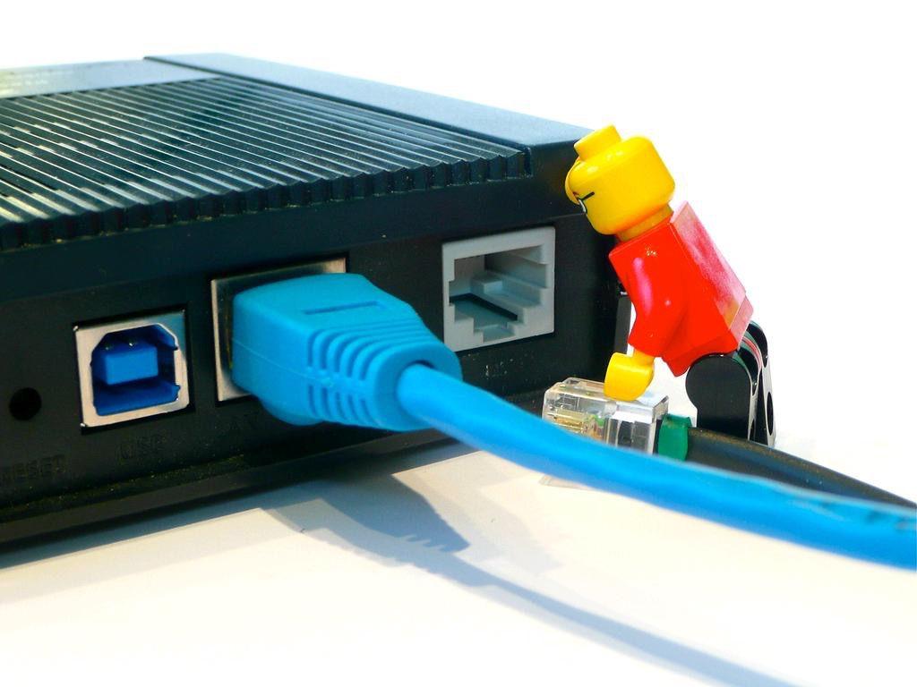
Is the Internet a place?
cc: ntr23 - https://www.flickr.com/photos/65919269@N00
Notes:
Ask
Is the Internet a place?
Encourage all student responses, but make sure students understand that the Internet is not a real place that you can physically visit, like a playground. However, it is made up of real people, who can connect with one another through computer connections even when they are not in the same place.

Slide 7
Circles of Connection
Notes:
ASK:
If the center circle is you, what people might be in the second circle?
GUIDE
students to understand that because this circle is the closest one to them, this circle should contain the people they are closest to in their lives. (You may wish to take this opportunity to make sure students understand the two possible meanings of the word close.) This would include family members, close friends, and other people who are important to them. Have them focus on people they see in person in their daily lives. Label the circle “My Family and Friends.”

Slide 8
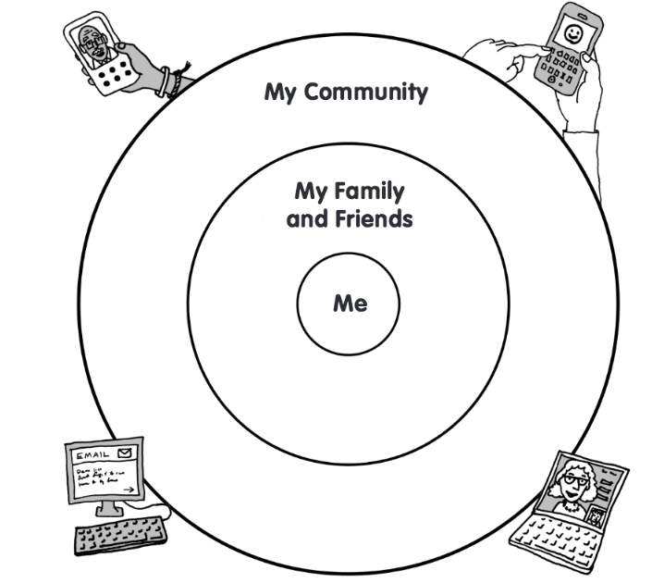
Online Community Map
Notes:
Teach 2
Online Community Map
DISTRIBUTE
copies of the Online Community Map Student Handout, one for each student. Also distribute scratch paper and colored pencils, crayons, or markers. You may wish to arrange students in groups so that they can share supplies.

Slide 9
Key Vocabulary
Community
People who share a common neighborhood, background, or interests
cc: jjackowski - https://www.flickr.com/photos/74762807@N00

Slide 10
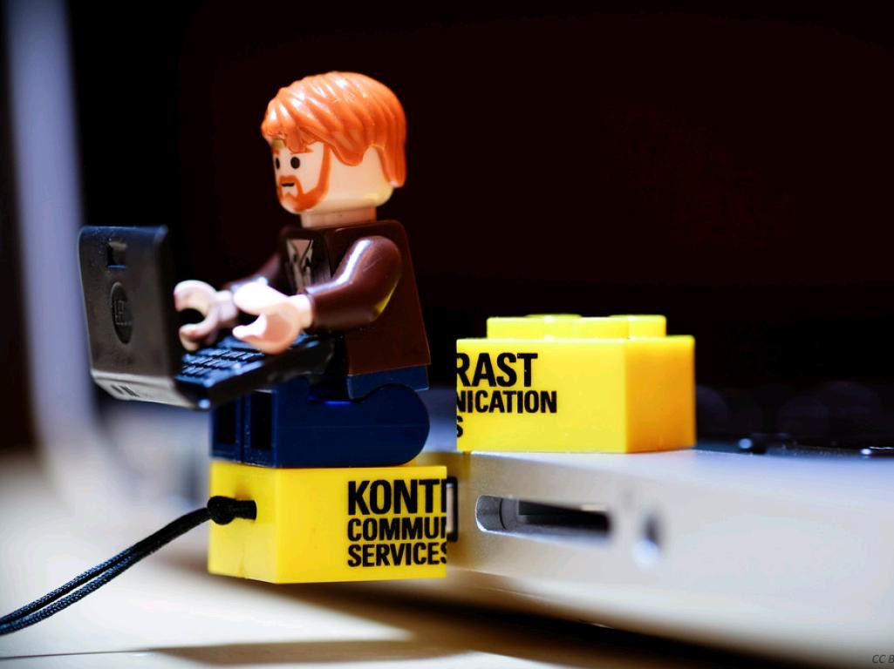
Think of anyone you connect with online by using email or social media with the help of a parent or other adult.
cc: BaneStudios - https://www.flickr.com/photos/39941973@N08
Notes:
Guide
the students using the TIPS suggestions.
ENCOURAGE
students to use scratch paper to list all of the people and places they connect with or would like to connect with on the Internet
INVITE
students to use the Online Community Map Student Handout to create a map of their online connections. They should write down or draw a simple picture of each person or place on their list, putting
it in the appropriate circle, depending on whether they are close friends and family or members of their
larger community.

Slide 11
Think of people you would like to connect with online.
As you get older and use the Internet more and more, these people will make up your online community.
cc: BaneStudios - https://www.flickr.com/photos/39941973@N08
Notes:
Guide
the students using the TIPS suggestions.
ENCOURAGE
students to use scratch paper to list all of the people and places they connect with or would like to connect with on the Internet
INVITE
students to use the Online Community Map Student Handout to create a map of their online connections. They should write down or draw a simple picture of each person or place on their list, putting
it in the appropriate circle, depending on whether they are close friends and family or members of their
larger community.

Slide 12
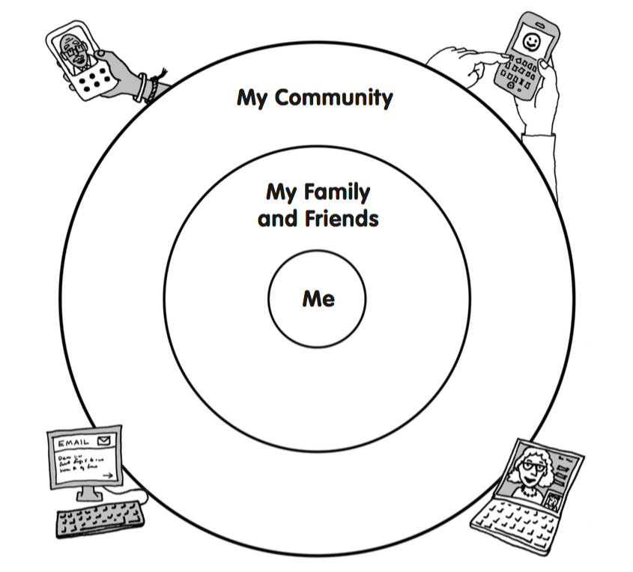
cc: BaneStudios - https://www.flickr.com/photos/39941973@N08
Notes:
Guide
the students using the TIPS suggestions.
ENCOURAGE
students to use scratch paper to list all of the people and places they connect with or would like to connect with on the Internet
INVITE
students to use the Online Community Map Student Handout to create a map of their online connections. They should write down or draw a simple picture of each person or place on their list, putting
it in the appropriate circle, depending on whether they are close friends and family or members of their
larger community.

Slide 13
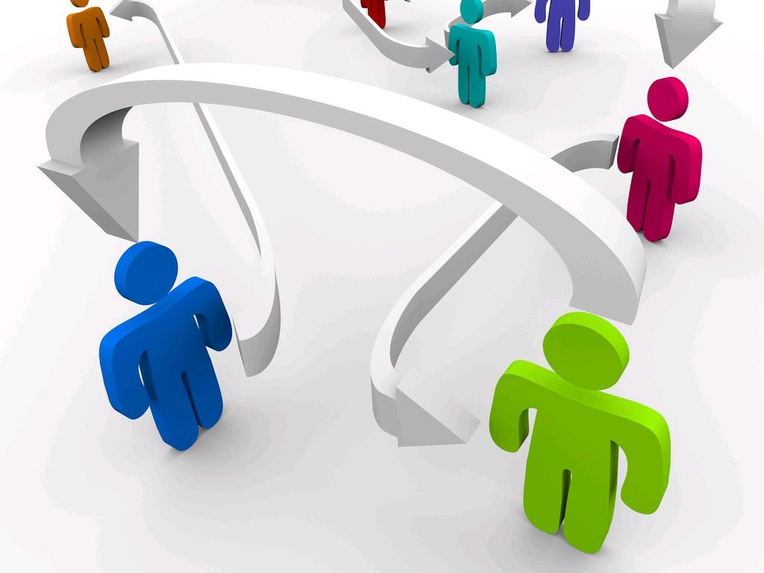
connecting the lines
cc: aquopshilton - https://www.flickr.com/photos/76804652@N02
Notes:
INSTRUCT
students to use lines to connect themselves to all the people in their online community. Tell them
that the lines represent connections through the Internet. Even though these people might be in different places, they are connected through invisible connections. Then encourage them to think about people who might
communicate with one another, and draw lines to connect them as well. For instance, they might draw a line between their grandpa and mom to show that they communicate, even if they live far away from one another.
DISPLAY
students’ maps and invite volunteers to use them to explain how computers connect people in their
neighborhood. Help students understand how the connections they have drawn help illustrate the definition
of Internet

Slide 14
Checking for Understanding
What do the lines on your maps show?
cc: Eric Constantineau - www.ericconstantineau.com - https://www.flickr.com/photos/74007022@N00
Notes:
Closing
Wrapping it up
You can use these questions to assess your students’ understanding of the lesson objectives
What is the difference between your in-person community and your
online community?
Their online community includes people they may not
see on a regular basis but with whom they could connect
on the Internet.
What do the lines on your maps show?
They show the Internet connections between students and the people in the online community they would like to create.
When you go online, do you really go somewhere?
Students might explain that their bodies don’t move, but that they might feel like they can visit places in their community

Slide 15
Checking for Understanding
What is the difference between your
in-person community and your
online community?
cc: Eric Constantineau - www.ericconstantineau.com - https://www.flickr.com/photos/74007022@N00
Notes:
Closing
Wrapping it up
You can use these questions to assess your students’ understanding of the lesson objectives
What is the difference between your in-person community and your
online community?
Their online community includes people they may not
see on a regular basis but with whom they could connect
on the Internet.
What do the lines on your maps show?
They show the Internet connections between students and the people in the online community they would like to create.
When you go online, do you really go somewhere?
Students might explain that their bodies don’t move, but that they might feel like they can visit places in their community

Slide 16
Checking for Understanding
When you go online,
do you really go somewhere?
cc: Eric Constantineau - www.ericconstantineau.com - https://www.flickr.com/photos/74007022@N00
Notes:
Closing
Wrapping it up
You can use these questions to assess your students’ understanding of the lesson objectives
What is the difference between your in-person community and your
online community?
Their online community includes people they may not
see on a regular basis but with whom they could connect
on the Internet.
What do the lines on your maps show?
They show the Internet connections between students and the people in the online community they would like to create.
When you go online, do you really go somewhere?
Students might explain that their bodies don’t move, but that they might feel like they can visit places in their community

