Slide 1
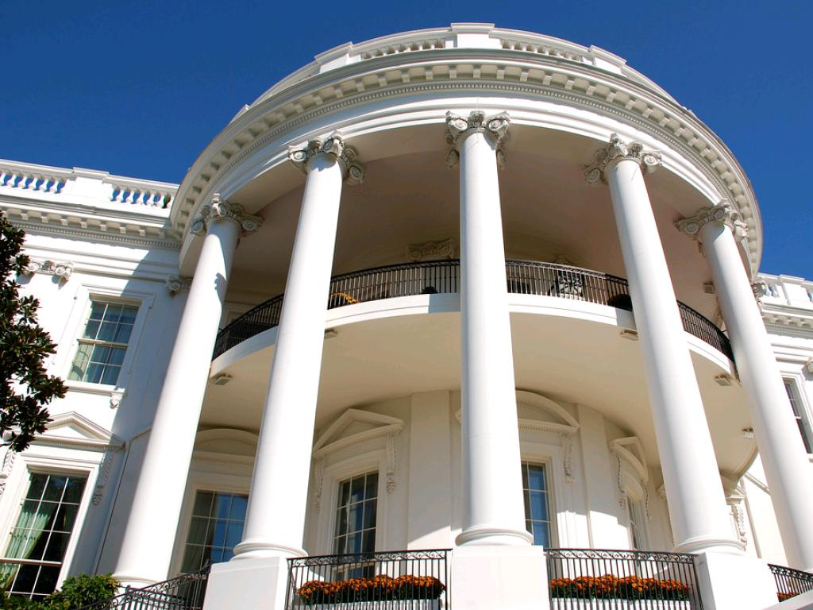
Privacy Rules
NLMUSD Cybersafety Grade 4
cc: afagen - https://www.flickr.com/photos/51035749109@N01

Slide 2
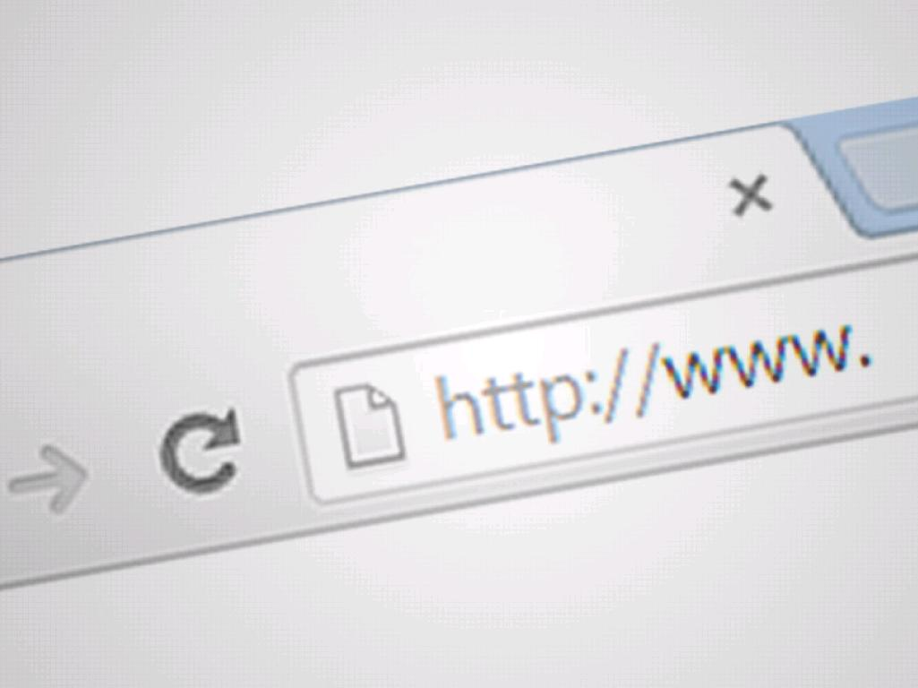
How do you know that a website protects your private information?
cc: thedescrier - https://www.flickr.com/photos/61502033@N02

Slide 3
In this lesson you will be able to
learn which information you should avoid sharing online because it is private.
understand which kinds of websites have privacy policies, and why.
practice checking websites they visit for privacy policies and privacy seals of approvals.
cc: mkhmarketing - https://www.flickr.com/photos/93212162@N08

Slide 4
Imagine if you had to wear a sign on the back of your shirt that had personal information about you?
cc: Wendi Gratz - https://www.flickr.com/photos/52621716@N00

Slide 5
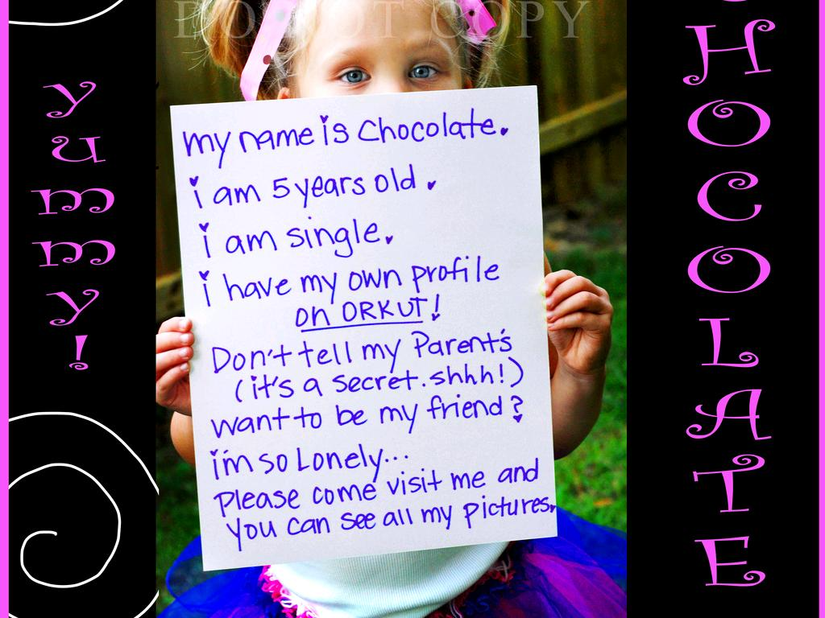
Personal information should not be shared with strangers, and some information such as private information, should be protected for safety reasons.
cc: dieselbug2007 - https://www.flickr.com/photos/58372737@N00

Slide 6
Private Information -information that can be used to identify you (for example, your Social Security number, street address, email, phone number, etc.)
cc: Nathan O'Nions - https://www.flickr.com/photos/50523792@N03

Slide 7
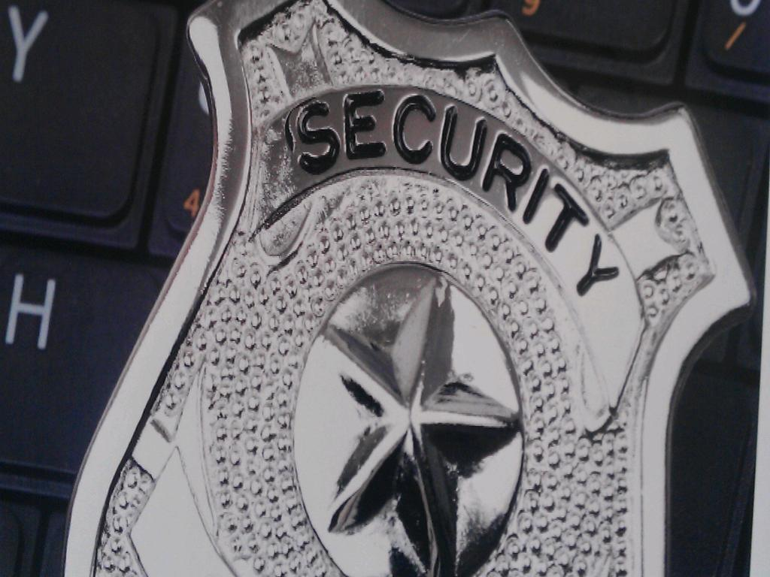
Know the Law
cc: Vanguard Visions - https://www.flickr.com/photos/77018488@N03

Slide 8
The United States has a law requiring website owners to help protect the private information of kids 13 and younger. The purpose of the law is to protect kids’ privacy.
cc: afagen - https://www.flickr.com/photos/51035749109@N01

Slide 9
The Law applies to websites
that have content meant for kids 13 and younger
that ask kids for private information
cc: Nick Kenrick. - https://www.flickr.com/photos/33363480@N05

Slide 10
This law is important because without it, websites could use your private information however they wanted. For example, a website could use your information to try to find you, contact you, and sell you things. Websites could even sell your private information to other companies who want information about kids.

Slide 11
Websites have to explain how they protect kids’ private information by posting a privacy policy.

Slide 12
Private Policy -a legal document that explains how a website gathers and uses your private information

Slide 13
In addition to a privacy policy, two organizations, the Better Business Bureau and TRUSTe, review children’s websites to make sure they are protecting kids’ privacy. If a kids’ website is following the privacy law, the Better Business Bureau and TRUSTe post their seals of approval on the site.

Slide 14
Seal of Approval -a sign or stamp that states that a website, company, or group meets a certain set of standards and is doing a good job

Slide 16
If someone gets your private information and uses it however they want, you might get a lot of junk mail or unwanted emails. Someone might try to sell you things you don’t want. Companies might share their private information with other companies who want to target kids.

Slide 17
You should make a habit of checking for yourselves to see if the kids’ sites you visit post privacy policies and have privacy seals of approval.

Slide 18
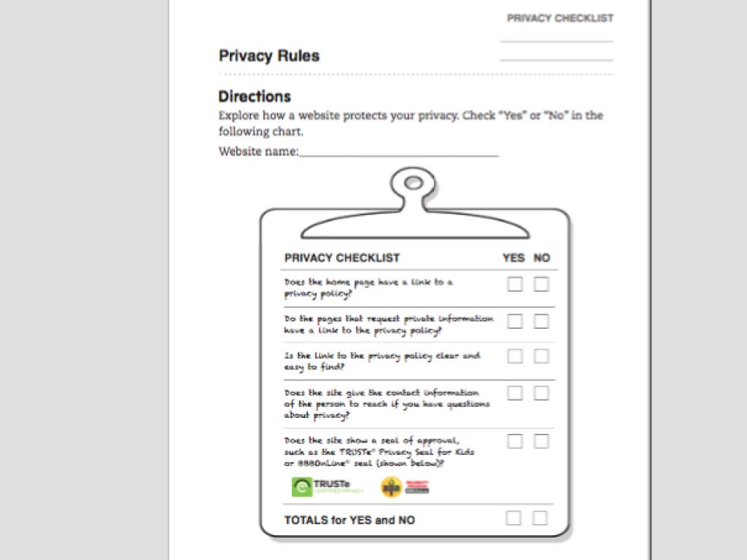

Slide 19
Assessment

