Slide 1
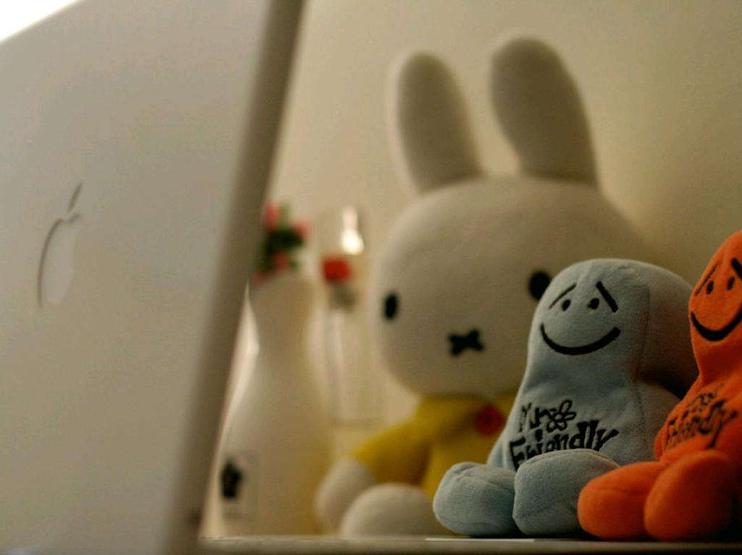
Private and Personal Information
NLMUSD Cybersafety 4th Grade
cc: l'interdit - https://www.flickr.com/photos/98666974@N00

Slide 2
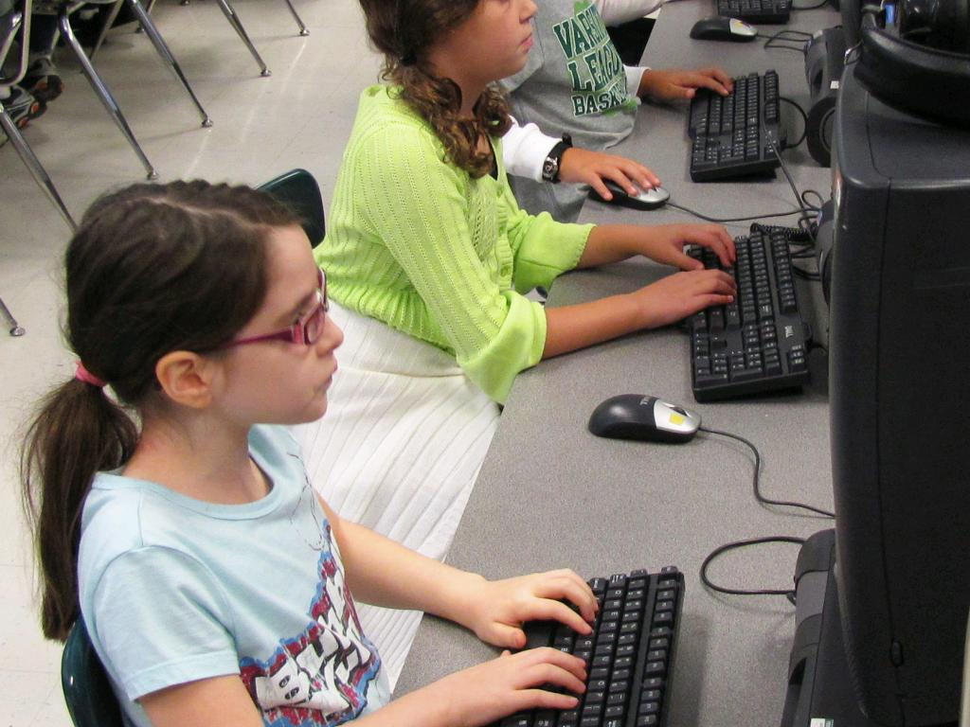
How can you protect yourself from online identity theft?
cc: woodleywonderworks - https://www.flickr.com/photos/73645804@N00

Slide 3
In this lesson, you will learn
learn about the benefits of sharing information online, but also about the safety and security risks of sharing certain types of information.
understand what type of information can put them at risk for identity theft and other scams.
distinguish between personal information, which is safe to share online, and private information, which is unsafe to share.

Slide 4
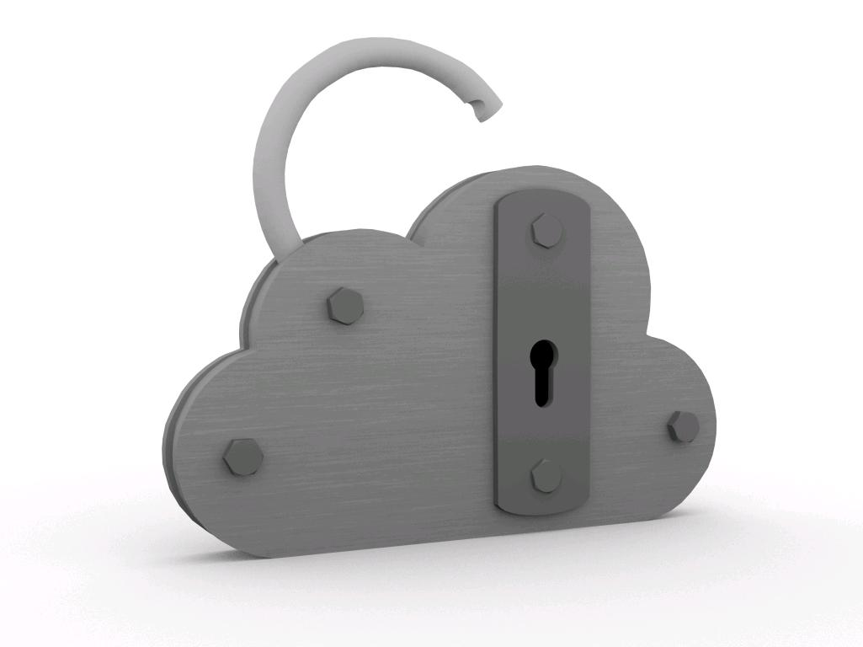
Discussion
cc: FutUndBeidl - https://www.flickr.com/photos/61423903@N06

Slide 5
Register (Online) -to enter your information in order to sign up and get access to a website

Slide 6
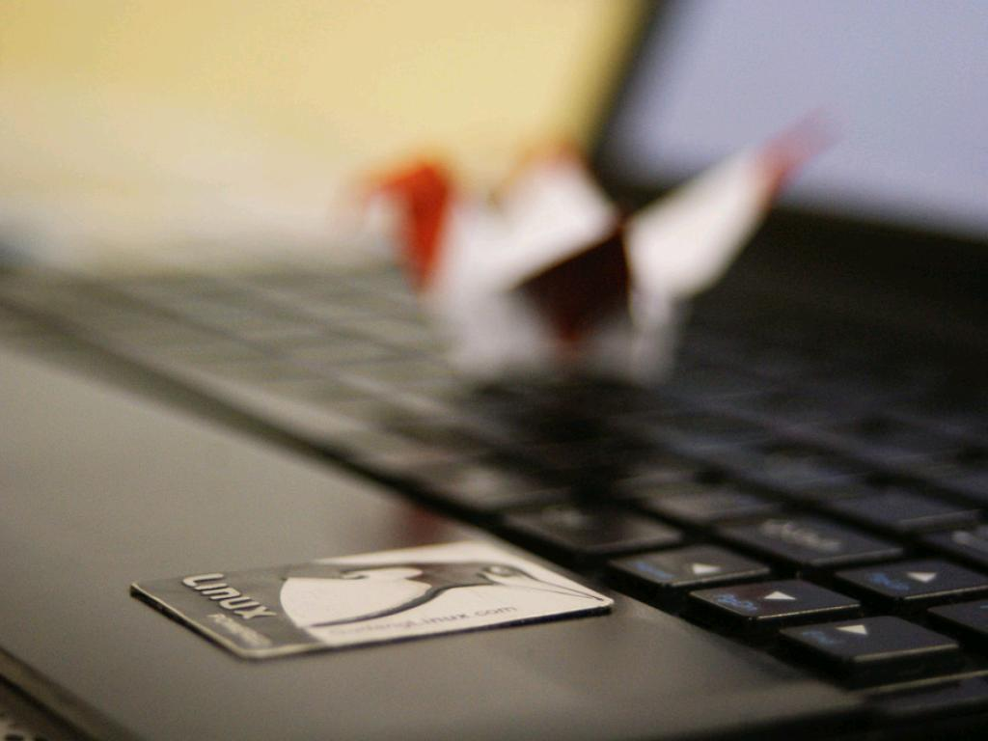
Discussion with Links
cc: Black_Claw - https://www.flickr.com/photos/24833567@N03

Slide 7
Some kinds of information are generally safe to share on the Internet and some are not. However, the information that’s considered safe should not be shared one-on-one with people they don’t already know offline.

Slide 8
personal information -to enter your information in order to sign up and get access to a website

Slide 9
private information -information that can be used to identify you, such as your Social Security number, street address, email, phone number, etc.

Slide 10
Personal information is usually safe to share online. Private information is usually unsafe to share online (students should get permission from a parent or guardian).

Slide 11
Safe-Personal Information
Your favorite food
Your respectful opinion
First Name

Slide 12
Unsafe-Private Information
Your mother's maiden name
Your social security number
Your birthday
Your parent's credit card
Your phone number

Slide 13
An identity thief uses private information to pretend to be the person whose identity he or she has stolen. Once the thief has taken someone’s identity, he or she can use that person’s name to get a driver’s license or buy things, even if the person whose identity they stole isn’t old enough to do these things! It’s often not until much later that people realize their identity has been stolen. Identity thieves may also apply for credit cards in other people’s names and run up big bills that they don’t pay off. Identity thieves often target children and teens because they have a clean credit history and their parents are unlikely to be aware that someone is taking on their child’s identity.

Slide 14
The difference between private information (which can be used to steal your identity) and personal information (which cannot be used to steal your identity).

Slide 15
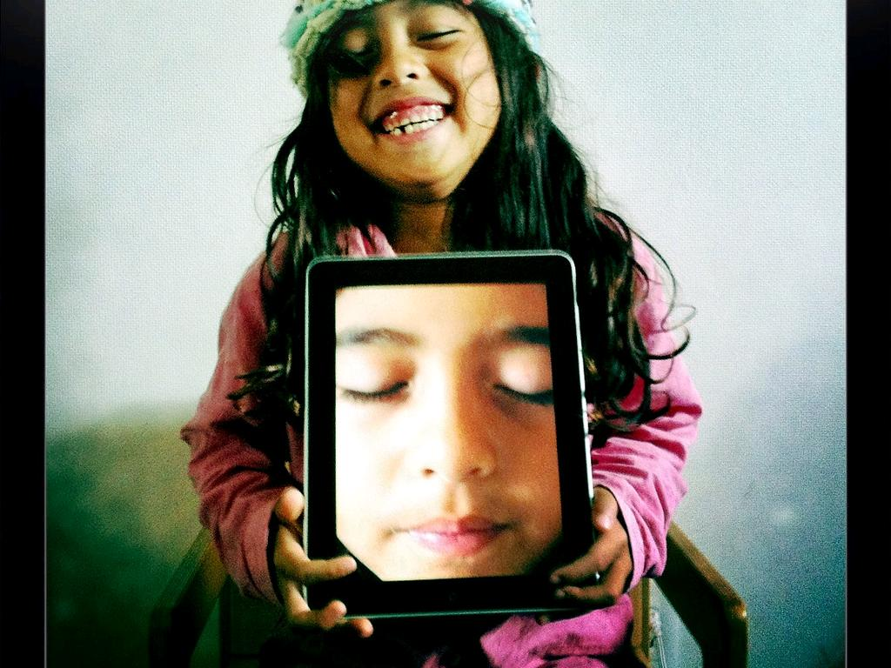
Discussion
cc: Lance Shields - https://www.flickr.com/photos/50064005@N00

Slide 16
On the Internet, people you interact with could be your friends next door or strangers who live on the other side of the world. Because it’s hard to know the intentions of people who you’ve never met before, it is best to remain cautious when sharing your information. You wouldn’t give strangers your private information in the real world, and you need to be just as careful when you’re online.

Slide 17
It is important that each time you share information online to stop and think: “Am I giving out information that I should keep private?” It can sometimes be safe to give out some private information. For example, a website might ask for your birth date or email address. But you should always ask your parent or guardian before giving out private information.

Slide 18
Which ones do you think are private?
Full Name
Street Address
Email Address
Date of birth
Gender
How many brothers and sisters you have
phone numbers
credit card
favorite food
Your pet's name
Your mother's maiden name
The name of your school

Slide 19
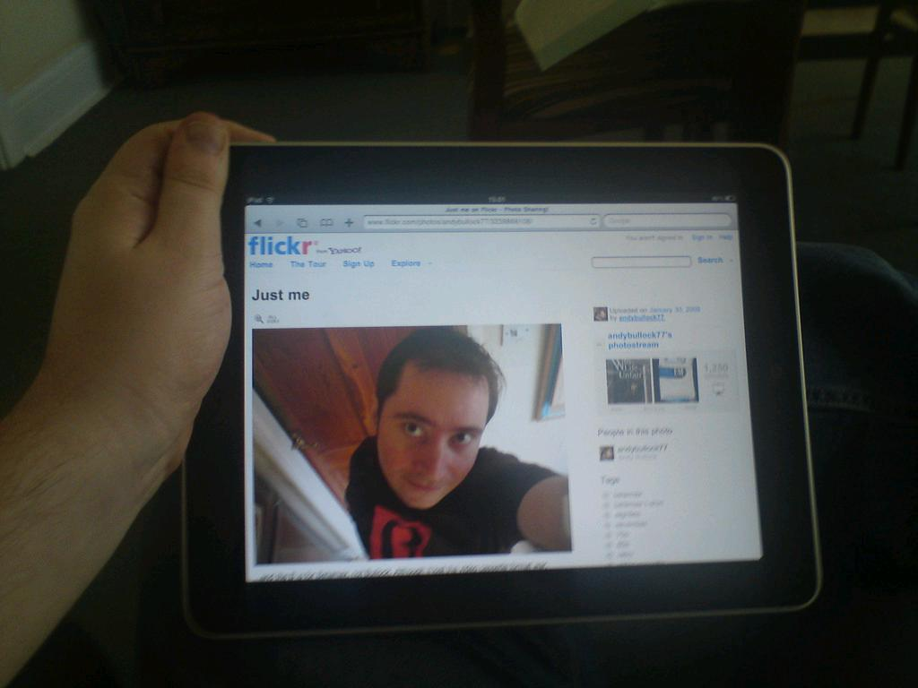
Discuss All About Me
cc: andybullock77 - https://www.flickr.com/photos/94549249@N00

Slide 20
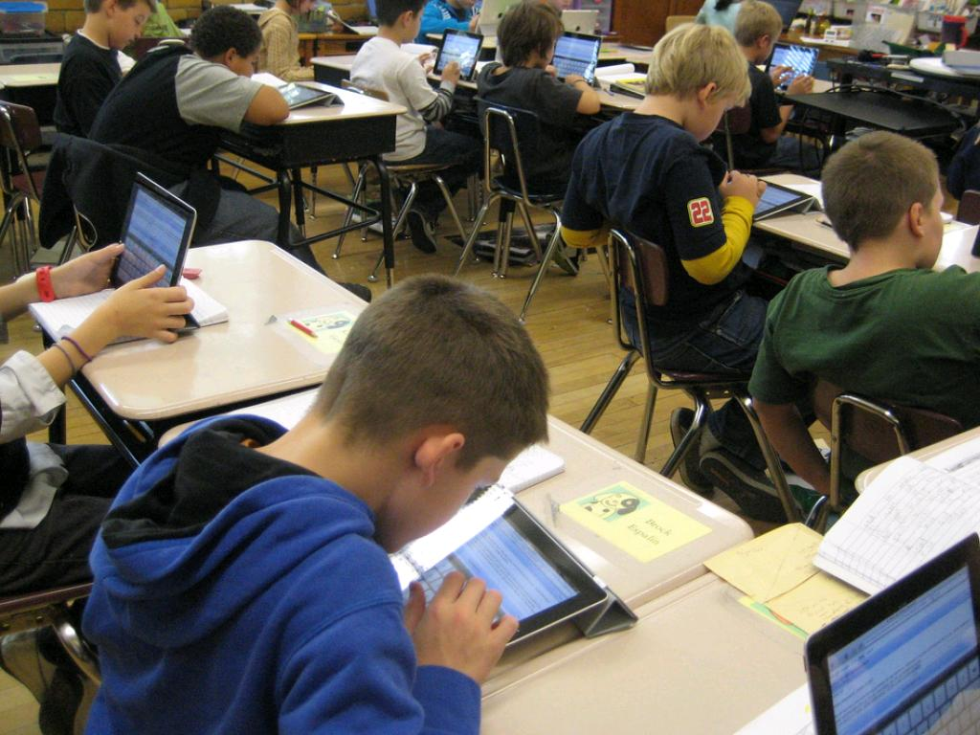
Assessment
cc: BarbaraLN - https://www.flickr.com/photos/46097950@N02

